Slide 1
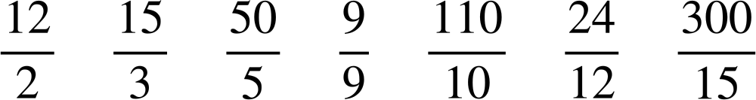
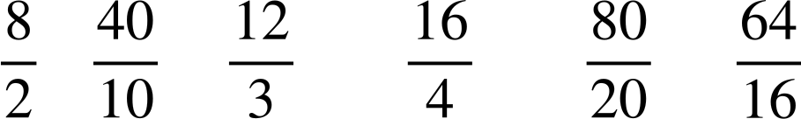
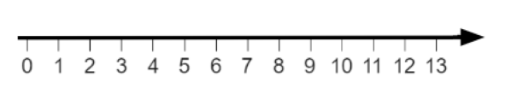
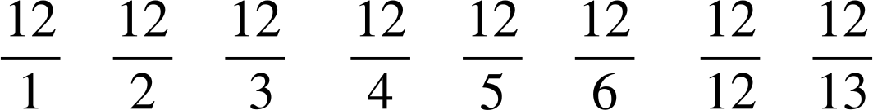
Checking and securing converting mixed numbers to improper fractions
Task A: Integers as improper fractions
1) Match the improper fraction with the correct integer.
2) Fill in the gaps to evaluate the answer to 4.
There are an infinite number of improper fractions which evaluate to 4
4
3) Place the following on the number line.
F
E
D
C
B
A
H
G
a)
e)
b)
f)
c)
g)
Estimate
where
would lie.
d)
Estimate
where
would lie.
h)

Slide 2




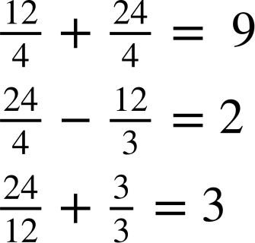
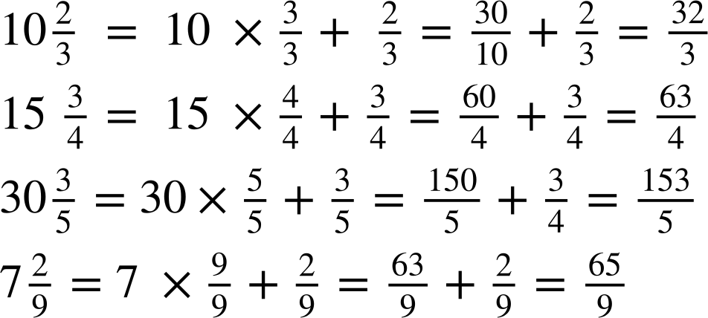
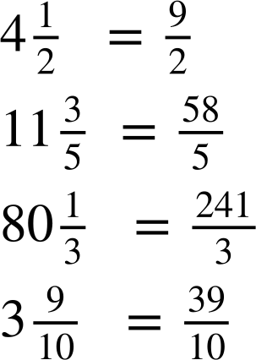
Checking and securing converting mixed numbers to improper fractions
4) The
,
,
and
are either
3
4
12
24
To make the above calculations correct, work out the value of the images.
= 12
= 4
= 3
= 24
Task B: Mixed numbers to improper fractions
1) Fill in the blanks to show the working out and conversion from a mixed number to an improper fraction.
a)
b)
2) Convert the following to improper fractions, showing working out if you need.
a)
b)
c)
d)

Slide 3
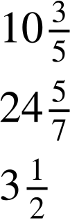

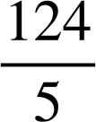
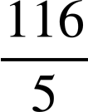
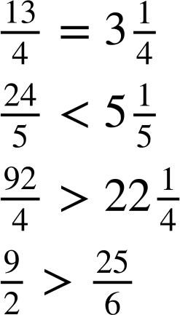
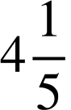


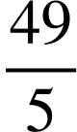
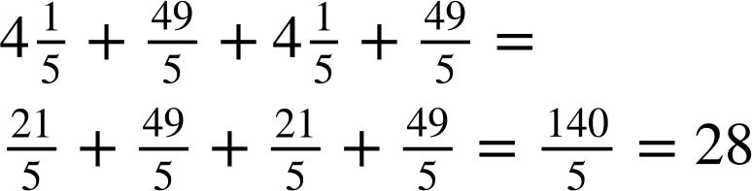
Checking and securing converting mixed numbers to improper fractions
3) Can you work out the mixed number given the clues for the integer and proper fraction?
Write your own mixed number with clues.
The integer is even.
The numerator and denominator of the proper fraction are both odd and prime numbers.
The integer is even.
As an improper fraction the numerator is 173.
The denominator is odd.
between
The mixed number is
and 10.7
between
and
Task C: Comparing mixed numbers and improper fractions
1) Insert the symbol <, > or = to make the following statements true.
a)
b)
c)
d)
2) Two gardeners are putting a fence around a rectangular garden.
One gardener measures the length to be
m
m and the other gardener measures
the
width
to be
m
m.
Fence panels cost £22 per m.
a) How many fence panels are needed?
b) What is the total cost?
28 × 22 = £616
fence panels

Slide 4
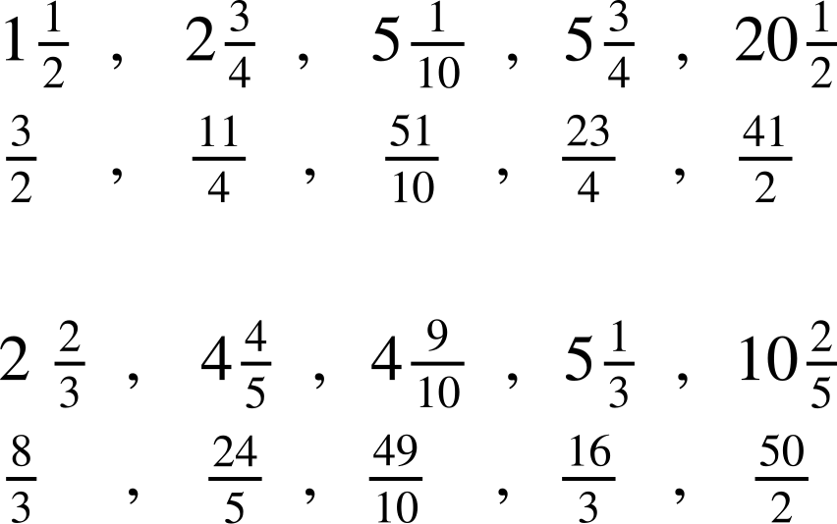
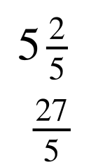
Checking and securing converting mixed numbers to improper fractions
3) The following have been put in ascending order.
The mixed number is above and the equivalent improper fraction is below.
Fill in the gaps.
a)
b)
Mathematics in Education and Industry
v2.2

